Slide 1
Intermediate Analytics ALY6015
Analysis of Airbnb houses in New York
Presented by:
Avinash Tripathi

Slide 2
Dataset
Using the dataset of New York’s Airbnb from Kaggle
Cleaning of data to avoid the null values, finding 16 null values. Filling them forward and backward filling
Decimal values being calculated using the mean of the column
Dimension of the columns are also calculated

Slide 3
Data Visualisation
Visualising the hotels according to
Placements of the Hotels
Variations of prices of hotels with area
Boxplot showing price variation
Type of Rooms
Rooms Vs Neighbourhood Group
Distribution of Room Availability and minimum number of nights

Slide 4
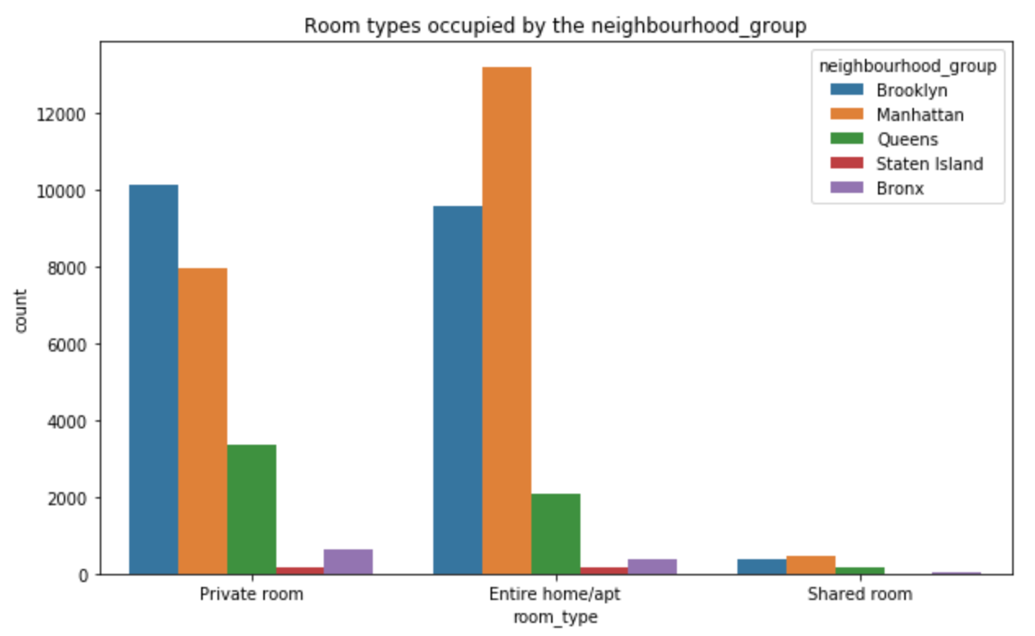
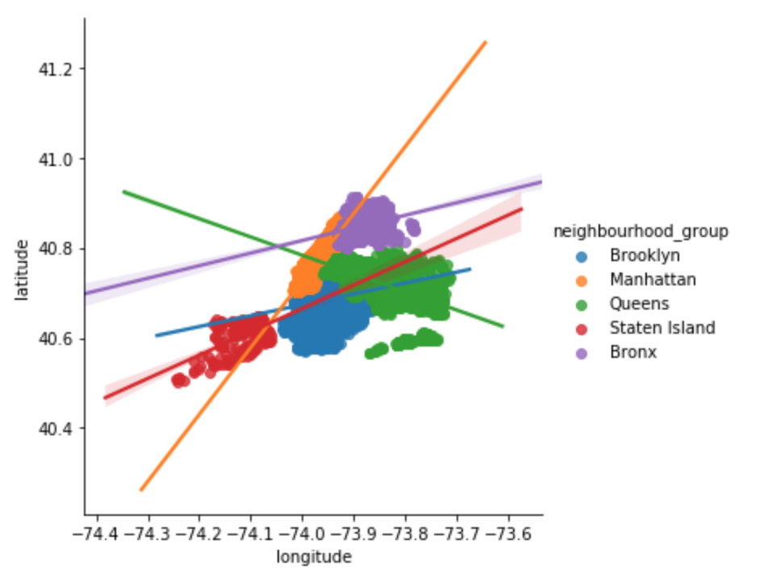
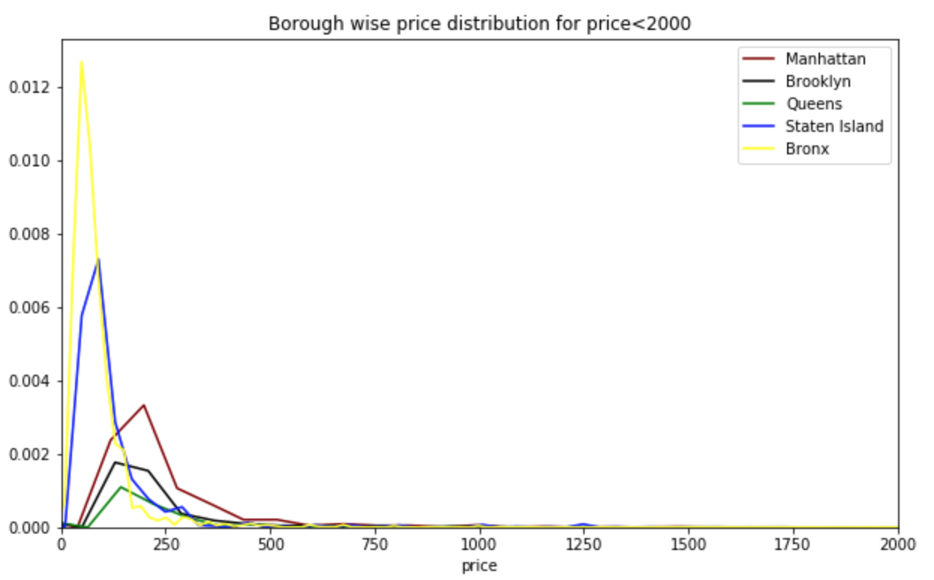
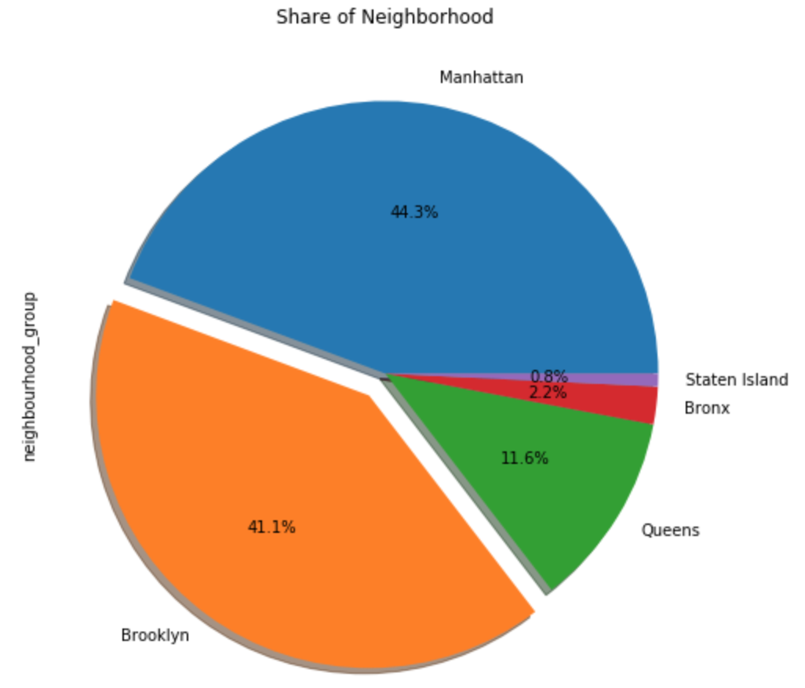

Slide 5
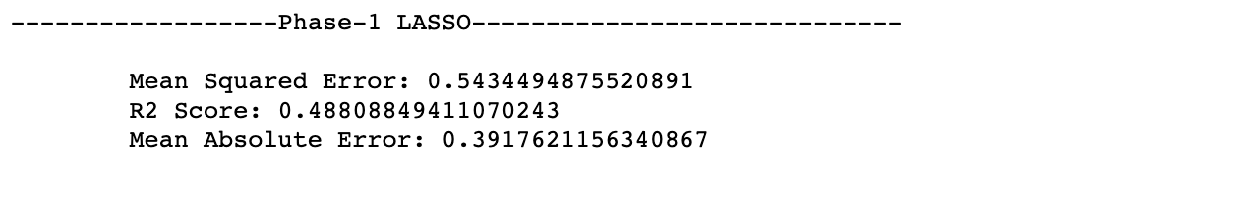
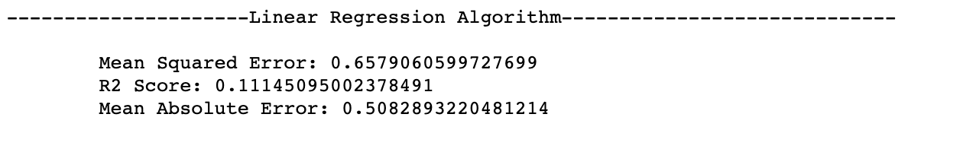
Feature Engineering
Using Linear Regression to fit the model, attempting to model the relationship between two variables by fitting a linear equation to observed data.
PCA is used to for checking for feature engineering and dimensional reduction
LASSO Regression is used here to reduce the dimensions to find the required features
.

Slide 6
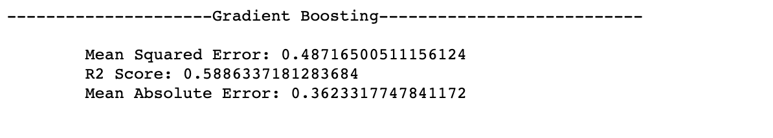
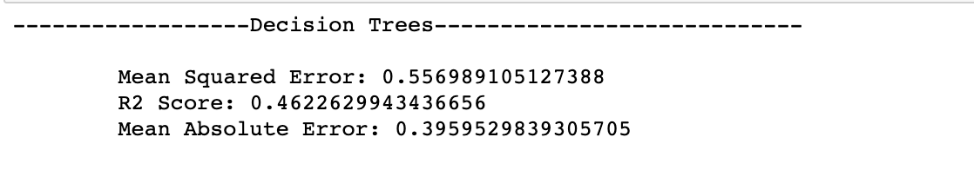
Model Building
Gradient boosting algorithm Helping to train the data throughout featuring all the variables equivalently
Decision tree is a decision support tool that uses a tree-like graph or model of decisions and their possible consequences, including chance event outcomes, resource costs, and utility

Slide 7
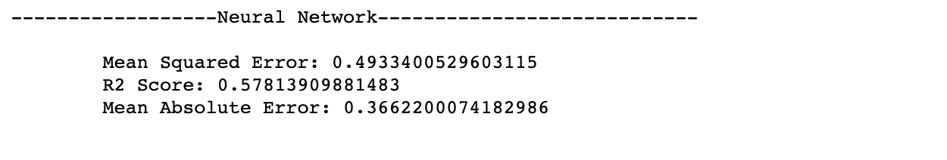
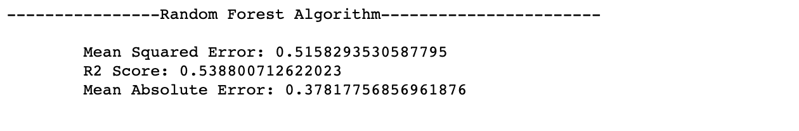
Model Building
Neural network are used to recognize pattern, and this is done by creating a web of algorithms which will generate some function and each function will compute some value.
Random forest is a collective learning method for classification, regression and other tasks that operate by making a multitude of decision trees at training time and then we get outputting the classes that is classification or regression of each tree.

